Slide 1
UE18CS390A – Capstone Project Review #3
(High Level Design and Proposed Methodology)
Project Title : Community detection in dynamic networks.
Project ID : 77
Project Guide : Prof. Sreenath MV
Project Team :
Name | SRN
Mahammad Thufail | PES2201800646
Manne Vasanth | PES2201800425
Purushotham S | PES2201800480
Pulle Manikya Sri Manasa | PES2201800468

Slide 2
Outline
Abstract
Summary of Literature Survey
Suggestions from Review – 2
Proposed Methodology / Design Approach
Architecture
Design Description
Technologies Used
Project Progress
References

Slide 3
Abstract
Elicit terrorist group networks from a database of terrorist events, finding most influential node and community detection :
We are using an approach that will allow us to find clusters of similar terror groups using information on their operational characteristics. Specifically, using open access data of terrorist attacks occurred worldwide since 1970, we are trying to build network that includes terrorist groups and related information on tactics, weapons, targets, active regions.
We model this data with each partition joined to the terrorist groups. Later on we will find the most influential group with maximum number of relations between other networks and try to prevent the attacks .Community detection to identify sets of nodes in such a way that the connections of nodes within a set are more than their connection to other network nodes.

Slide 4
Literature Survey
Paper Details | Objective of paper, Techniques/Methods | Advantages | Limitations
Nesrine Hafiene, Wafa Karoui1, and Lotfi Ben Romdhane “Influential Nodes Detection in Dynamic Social Networks” | The main idea is to propose an approach that contains two phases. Indeed, the first phase of SNDUpdate explores the structural aspect of the network and the second phase concentrates on the semantic aspect.This approach can be considered to be an extension of a previous static algorithm SND (Semantic and structural influential Nodes Detection). | Experimental studies carried out on the selected networks shown how it is possible to obtain good results in the detection of nodes that maximize the influence propagation. Empirical studies show that this algorithm has great improvement on the influence propagation compared with IMM, Degree and DIM algorithms.Experimental results prove the effectiveness of SND Update to detect influential nodes in dynamic social networks. | The influence maximization problem aims to identify influential nodes allowing to reach the viral marketing objectives on social networks. Previous researches are mainly concerned with the static social network analysis and the development of algorithms in this context. However, when network changes, those algorithms must be updated.

Slide 5
Literature Survey
Paper Details | Objective of paper, Techniques/Methods | Advantages | Limitations
Mohamed EL-Moussaoui, Tarik Agouti, Abdessadek Tikniouine, Mohamed Eladnani “Community detection: Approaches and applications”. Paper 2019 | Community Detection in Complex Network Analysis,to reveal cohesive and meaningful subgaph,recognize the features,functions,structure and dynamic of complex networks;and identifying communities in given complex networks through community detection approaches. | To enhance the efficiency of identifying communities in complex networks in case of undirected networks and the approaches based on the static and dynamic communities through the fundamental concepts like network measurements ,network structures and community structures. We performed a comparison of different works basing on characteristics that differ from approach to another. | Nowadays, the field of community detection still in development, and the categorization of an exhaustive list of methods and approaches seems not yet fixed.

Slide 6
Literature Survey
Paper Details | Objective of paper, Techniques/Methods | Advantages | Limitations
Punam Bedi and Chhavi Sharma " Community detection in social networks ". Paper 2016 | Clustering-based Community Detection, Genetic Algorithms (GA)-based Community Detection, Label Propagation-based Community Detection, Methods to Detect Overlapping Communities and Community Detection for Dynamic Networks. | The method to be used at any point may be decided on the basis of the structure of the network and kind of communities. An algorithm that may be time and space efficient and hence suitable for a particular network type may prove expensive in another case. Depending upon various parameters and network topological characteristics, the output of a method may differ in different scenarios. | Communities are growing exponentially in social networks. Each algorithm for different types of community detection has their own respective disadvantages.

Slide 7
Literature Survey
Paper Details | Objective of paper, Techniques/Methods | Advantages | Limitations
Vinicius da Fonseca Vieira, Carolina Ribeiro Xavier, Nelson Francisco Favilla Ebecken and Alexandre Goncalves Evsukoff “Performance Evaluation of Modularity Based Community Detection Algorithms in Large Scale Networks”. Paper 2014 | A community structure in a network can be identified when there is a division of the network in groups with high density of internal connections and, at the same time, low density of external connections. The community sense becomes more evident as the difference between the intragroup and intergroup increases. Thus, it is a central concern to quantify the quality of a particular division of the network in communities. | This work aims at the investigation of the computational issues of methods for community detection which enable them to deal with large scale networks. The implementation of the fine-tuning stage proposed in this work considers a reduction in the number of swapped nodes, which enables an up to 50% faster execution without harming the quality of the partitions obtained. | When the number of moved nodes is increased to 20% of the nodes (Newman-FT20%), the obtained modularity, in almost all the tested networks, is the same to the value obtained when 100% of the nodes are moved. In other words, in most cases, the permutation of more than 80% of the nodes in the fine-tuning stage only causes a huge waste of time and computational resources.

Slide 8
Summary of Literature Survey in Review 2
Analyzing the composition and evolution of terrorist group networks.
Finding influential nodes in social networks based on neighborhood correlation coefficient
Predict the characteristics of the actors, the appearance of any links, the arrangements of difusion in the network.
Hidden Community Detection, for identifying the hidden community structure as well as enhancing the detection of the dominant community structure.
The scoring criterion reduces the overlap of seed nodes, and this leads to the selection of K-node with optimal infuence spread.
Proposed a schema to identify the most influential nodes that are based on network measures that includes Degree, Betweenness Centrality, Closeness Centrality, Eigenvector Centrality, Page Rank and Clustering Coefficient.

Slide 9
Suggestions from Review – 2
We were informed to do further research on couple of literature surveys for better understanding of the topic.
To improvise community detection algorithm.

Slide 10
Design Details
Novelty:
The prediction of terrorist network and identifying main actors is an important issue for intelligence and security informatics, and few of the researches lack in this aspect. So we propose a method to analyze social network using some machine learning techniques (ie.,K-Core Concepts). Once the networks are clustred accordingly then we then use methodology based on community detection to determine the relationships of the terrorist node within the same cluster as well as the terrorist nodes from different clusters.
Innovativeness:
The approach that we proposed elicits terrorist group’s networks, finds most influential nodes and temporal evolution of terrorist networks, but it is not an open-source model instead these data are shared with national intelligent management for protecting nation from terrorist threats and implement counter terrorism activity.

Slide 11
Design Details
Performance:
Performance is also the main aspect of this approach, because the approach that we proposed has a better efficiency since we measure it by considering the number of nodes that can instantly access a large number of different nodes through a relatively small number of ties. The nodes are treated as nonredundant contacts.
Maintainability:
We need to use a good ranking methods and algorithms to make sure it is showing right results to the users. We would also assign weights to the nodes so that there will be change in importance of identifying the community accordingly as the time goes on. These ranking methods have to be tested and updated time to time to ensure good working of the tool. The retrieval of results from the underlying search engines is achieved using their respective API’s which are free of cost. Maintenance would be required if their respective policies changes.

Slide 12
Design Details
Reliability:
The algorithm we use is capable of performing operations using the data got from the terrorist database and is producing results in a time which we could think of other tasks to perform. It is reliable for the kind of data we use and the efficient results produced at the end.
Legacy to modernization:
To gain operational efficiencies as per the legacy modernization we are updating and optimizing business systems by enabling graphical access to government agencies who could actually view each community growth and the influential node in a single display graphical view. This makes user achieve their expectations in their experience and getting easily adopted to other newer technology platforms.

Slide 13
Design Details
Application compatibility:
As our project is capable of operating in different operating systems and its environment is also user-friendly, it allow us to automate the process of testing where all the application is tested for their compatibility at once. Enabling auto removing of the features which is not supported by the operating system is achieved to a certain extent.
Resource Utilization:
There is huge data to be processed and most of it are not needed for the kind of results we expect. So we kind of use only the results which has huge impact on terrorist growth and which also needed for the future link prediction among the groups. The community detection almost enables us to know the relation between different communities and their growth over time. So the data is utilized as per our intermediate needs and predictions.

Slide 14
Proposed Methodology / Approach
Understanding the composition and evolution of terrorist group networks: A rough set approach.
Selecting relevant features
Building rough conceptualizations of terrorist groups
Building boundary regions for terrorist groups
Building Similarity matrix
Designing the terrorist groups network

Slide 15
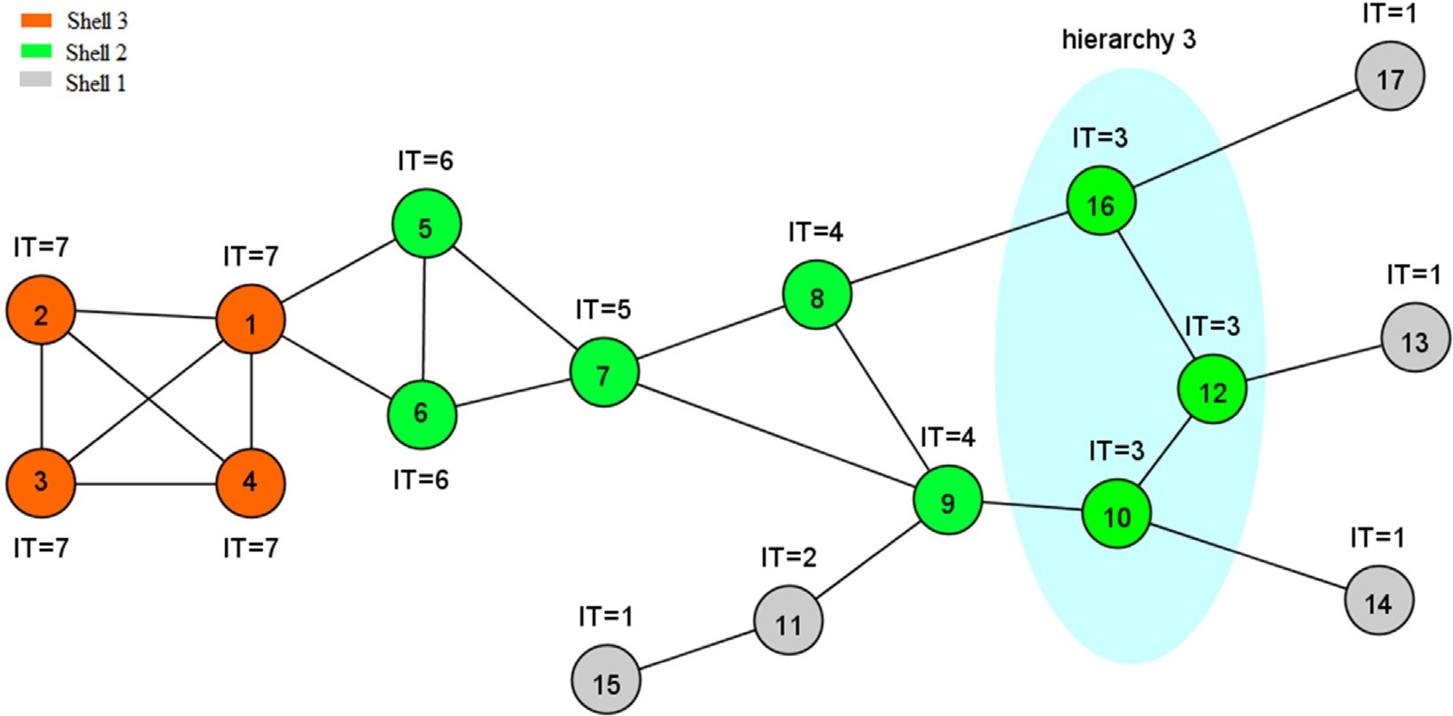
Proposed Methodology / Approach
Finding influential nodes in social networks based on neighborhood correlation coefficient.
In the proposed approach, we consider common hierarchy between a node and its neighbors rather than the number of their common neighbors. To this end, the network is first divided into different parts. Nodes that are removed in the same iterations of the k-shell algorithm can be assumed to be in the same hierarchy.

Slide 16
Proposed Methodology / Approach
Community Detection in social networks : Communities are calculated by maximizing the objective function in a two-step optimization in each one of the iterations.
Louvain algorithm using locality modularity optimization:
In the first step, small communities are formed by optimizing the modularity locally. Only local changes of communities are allowed in this step.
In the following step, nodes belonging to the same community are aggregated in a single node that represents a community in a new aggregated network of communities.
Iteratively these steps are repeated until no increase in modularity is possible with a hierarchy of communities being produced.
Once the original algorithm does not allow the addition or removal of new nodes and edges after obtaining the community structure, a re-computation of the communities starting from an initial network is necessary.

Slide 17
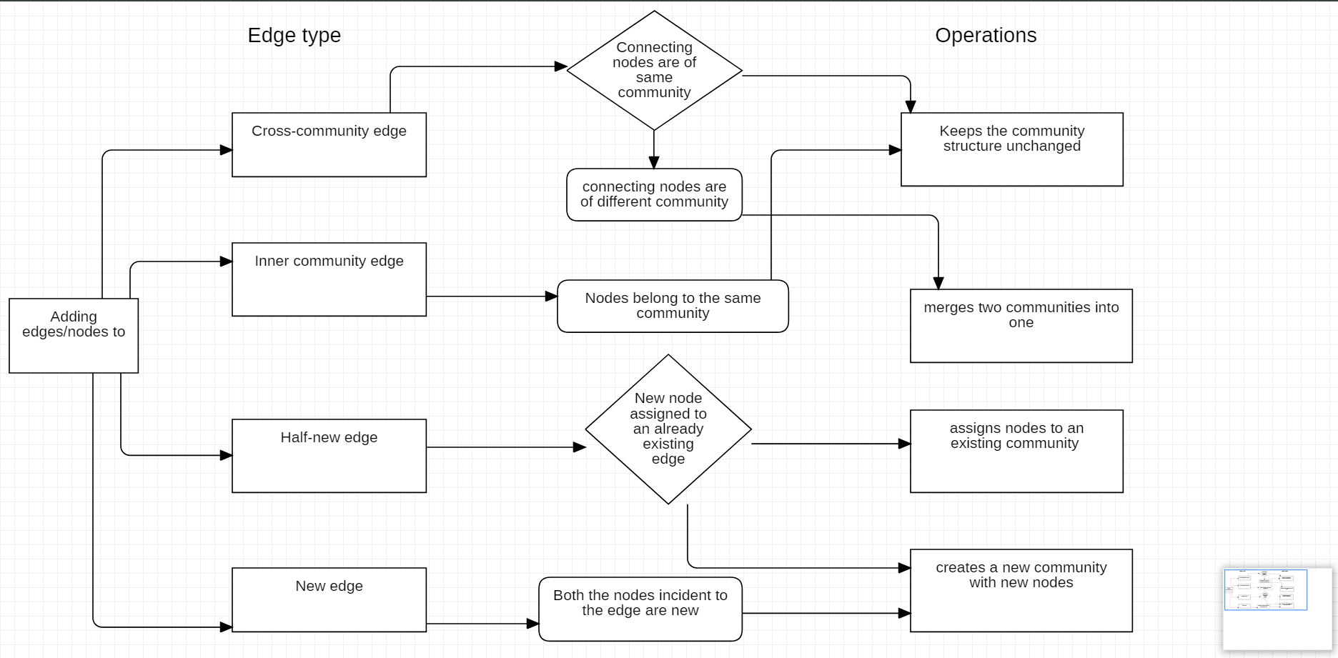
Proposed Methodology / Approach
Adding nodes/edges:

Slide 18
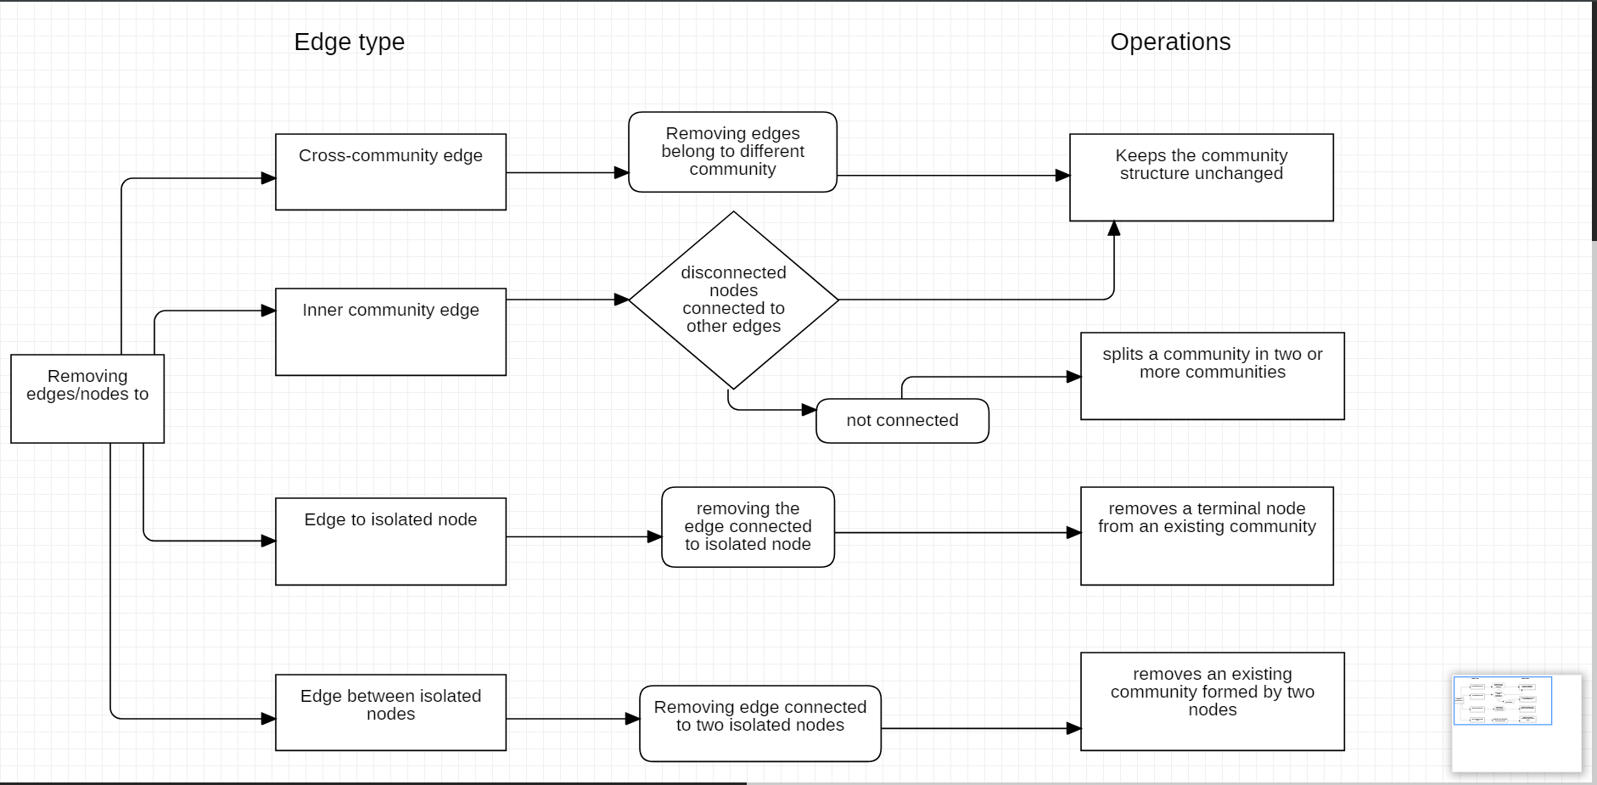
Proposed Methodology / Approach
Removing nodes/edges:

Slide 19
Proposed Methodology / Approach
To enable true dynamic graph community detection, the Louvain Method was modified to support incremental community structure changes when nodes are added or removed from the network.
The quality of communities obtained by the Dynamic Louvain in the incremental network scenario had a slightly higher variance in modularity compared to the original Louvain.
Why this algorithm is better:
Optimization: Our algorithm only performs community detection in the full network only at the first snapshot.
Efficiency: The modified Louvain steps will only compute communities which are affected by addition or removal of nodes/edges.
Stability: In the proposed algorithm, unaffected communities keep unchanged. Therefore, they preserve the same nodes and even the same community id between snapshots.

Slide 20
Technologies Used
NetworkX : For the creation, manipulation, and study of the structure, dynamics, and functions of complex networks.
igraph : It is a collection of network analysis tools with the emphasis on efficiency, portability and ease of use.

Slide 21
Project Progress
We have made literature survey and have come up with a proper approach.
The algorithm for implementation/execution is decided.

Slide 22
Capstone (Phase-I & Phase-II) Project Timeline
March 9 2021
March 25 2021
April 9 2021
Finalising the Algorithm
Literature Survey
Finalising requirements for the project
Discussing and finalising the approach and understanding required technology
Working on part 1 of the project
Timeline on Deliverable-1

Slide 23
Capstone (Phase-I & Phase-II) Project Timeline
June 25 2021
July 15 2021
July 31 2020
Partial implementation of model
Final implementation
Present final system and start working on making a research paper
Submit the project for review and make journal on our implementation of project.
Timeline on Deliverable-2

Slide 24
Conclusion
Since the Proposed Methodology / Approach have algorithms with lesser time and space complexity which performs well, It is expected to provide better results.

Slide 25
Nesrine Hafiene,Wafa Karoui1, and Lotfi Ben Romdhane “Influential Nodes Detection in Dynamic Social Networks”. Paper 2019
https://link.springer.com/chapter/10.1007%2F978-3-030-20482-2_6
Mohamed EL-Moussaoui, Tarik Agouti, Abdessadek Tikniouine, Mohamed Eladnani “Community detection: Approaches and applications”. Paper 2019
https://www.sciencedirect.com/science/article/pii/S1877050919305046
Punam Bedi and Chhavi Sharma “ Community detection in social networks ". Paper 2016
https://www.researchgate.net/publication/295395520_Community_detection_in_social_networks
Vinicius da Fonseca Vieira, Carolina Ribeiro Xavier, Nelson Francisco Favilla Ebecken and Alexandre Goncalves Evsukoff “Performance Evaluation of Modularity Based Community Detection Algorithms in Large Scale Networks”. Paper 2014
https://www.hindawi.com/journals/mpe/2014/502809/
References

Slide 26
Thank You

